Slide 1
Database
External Sort

Slide 2
Why Sort?
A classic problem in computer science!
Data requested in sorted order
  e.g., find students in increasing gpa order
Sorting is useful for eliminating duplicate copies in a collection of records
Problem: sort 1Gb of data with 1Mb of RAM.

Slide 3
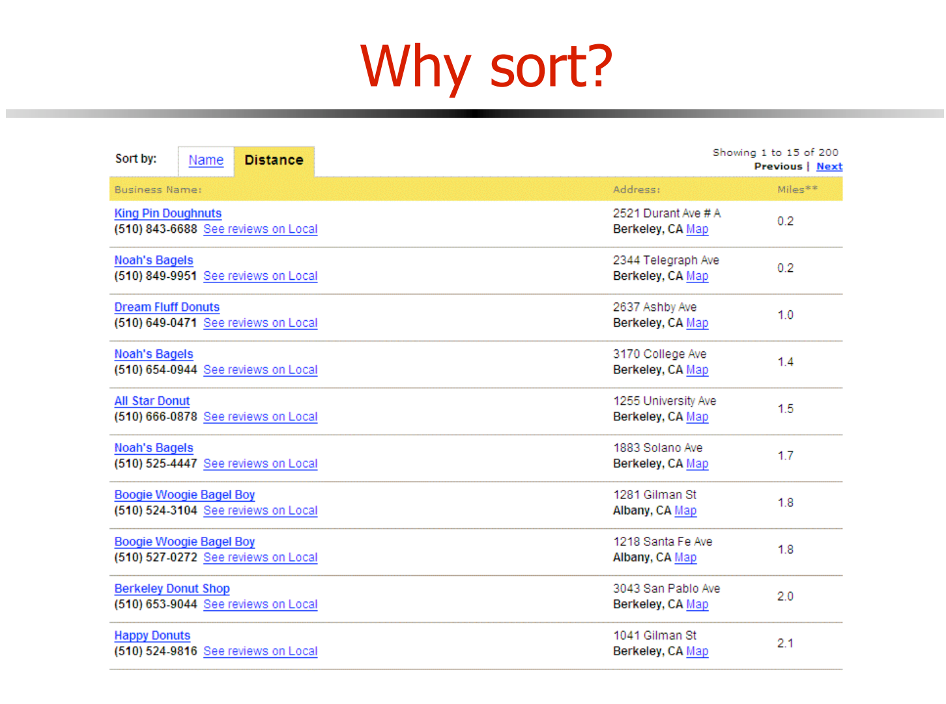

Slide 4


Slide 5
External Sort-Merge
Let B denote memory size (in pages).
Create sorted runs. Let i be 0 initially.
Repeatedly do the following till the end of the relation:
(a) Read B blocks of relation into memory
(b) Sort the in-memory blocks
(c) Write sorted data to run R_{i}; increment i.
Let the final value of i be n
Merge the runs (n-way merge). We assume (for now) that n <B.
  Use n blocks of memory to buffer input runs, and 1 block to buffer output. Read the first block of each run into its buffer page
  repeat
    Select the first record (in sort order) among all buffer pages
    Write the record to the output buffer. If the output buffer is full write it to disk.
    Delete the record from its input buffer page.
    If the buffer page becomes empty then
    read the next block (if any) of the run into the buffer.
  until all input buffer pages are empty:

Slide 6
External Sort-Merge (Cont.)
If n≥ B, several merge passes are required.
  In each pass, contiguous groups of B - 1 runs are merged.
  A pass reduces the number of runs by a factor of B -1, and creates runs longer by the same factor.
    E.g. If B=11, and there are 90 runs, one pass reduces the number of runs to 9, each 10 times the size of the initial runs
  Repeated passes are performed till all runs have been merged into one.

Slide 7
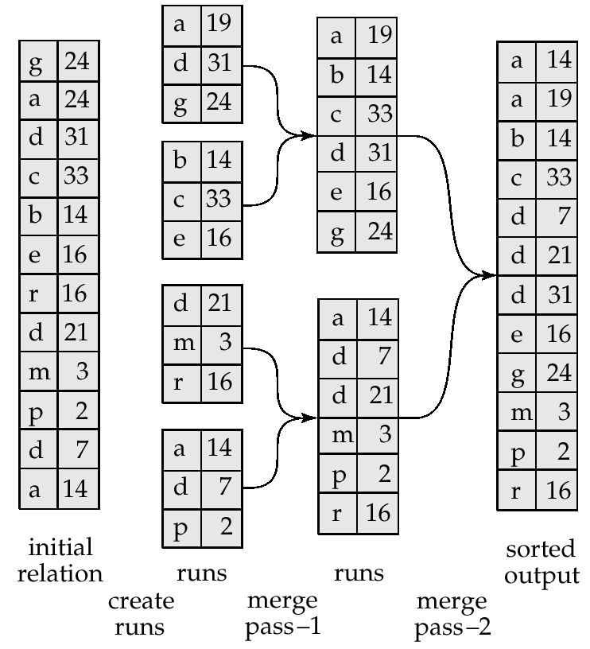
Example: External Sorting Using Sort-Merge
B=3

Slide 8
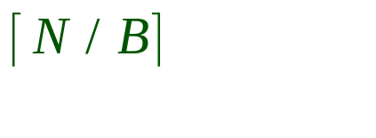
General External Merge Sort
B buffer pages. How can we utilize them?
To sort a file with N pages using B buffer pages:
  Pass 0: use B buffer pages.
  Produce sorted runs of B pages each.
  Pass 1, 2, …, etc.: merge B-1 runs.
INPUT 1
. . .
INPUT 2
. . .
. . .
OUTPUT
INPUT B-1
Disk
Disk
B Main memory buffers
Notes:
7

Slide 9
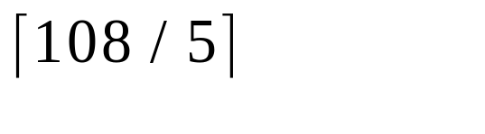
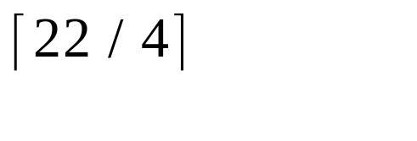

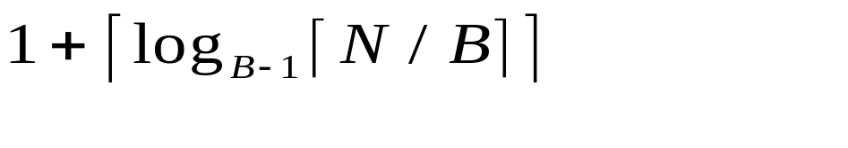
Cost of External Merge Sort
E.g., with 5 buffer pages, to sort 108 page file:
  Pass 0: = 22 sorted runs of 5 pages each (last run is only 3 pages)
  Pass 1: = 6 sorted runs of 20 pages each (last run is only 8 pages)
  Pass 2: =2 sorted runs of 80 pages and 28 pages
  Pass 3: Sorted file of 108 pages
Number of passes:
Cost = 2N * (# of passes)
Notes:
8

Slide 10
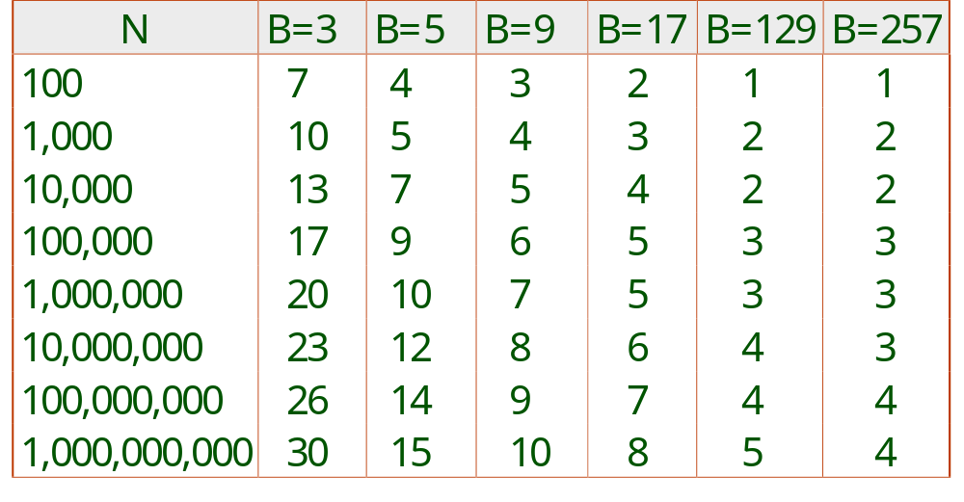
Number of Passes of External Sort
Notes:
9

